Slide 1
Chapter 11
Solution of Differential Equations with MATLAB
MATLAB has some powerful features for solving differential equations of all types. We will explore some of these features for the CCLODE forms. The approach here will be that of the Symbolic Math Toolbox. The result will be the form of the function and it may be readily plotted with MATLAB.

Slide 2
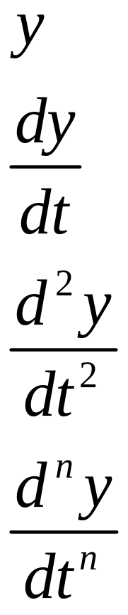
Symbolic Differential Equation Terms
y
Dy
D2y
Dny

Slide 3
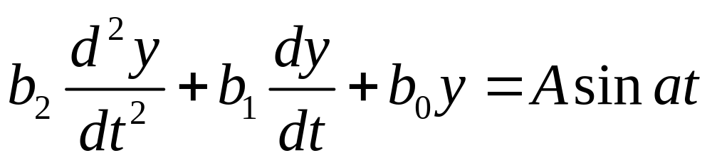
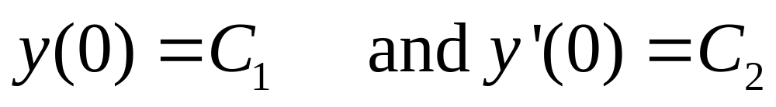
Representative CCLODE Form
>> y = dsolve(‘b2*D2y+b1*D1y+b0*y=A*sin(a*t)’,
‘y(0)=C1’, ‘Dy(0)=C2’)
>> ezplot(y, [t1 t2])

Slide 4
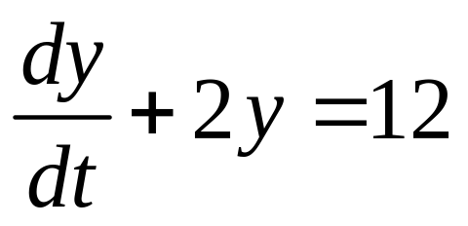
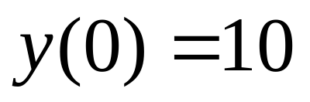
Example 11-1. Solve DE below with MATLAB.
>> y = dsolve('Dy + 2*y = 12', 'y(0)=10')
y =
6+4*exp(-2*t)
>> ezplot(y, [0 3])
>> axis([0 3 0 10])

Slide 5
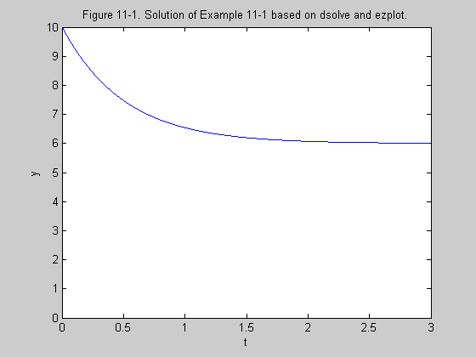

Slide 6
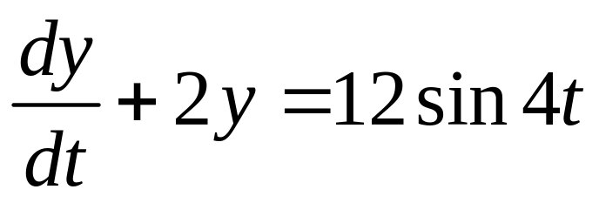
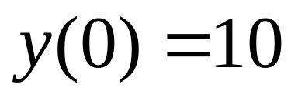
Example 11-2. Solve DE below with MATLAB.
>> y = dsolve('Dy + 2*y = 12*sin(4*t)', 'y(0)=10')
y =
-12/5*cos(4*t)+6/5*sin(4*t)+62/5*exp(-2*t)
>> ezplot(y, [0 8])
>> axis([0 8 -3 10])

Slide 7
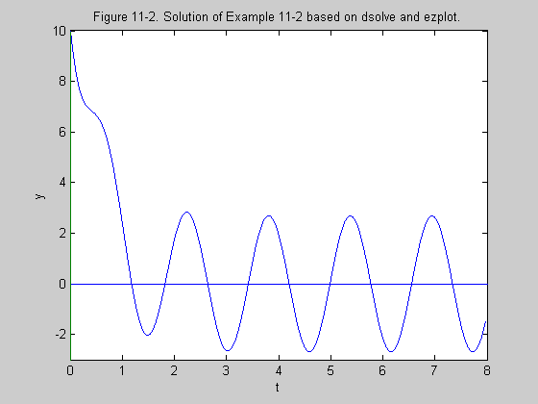

Slide 8
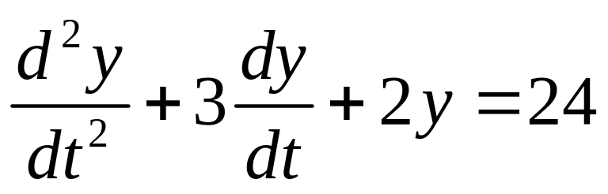
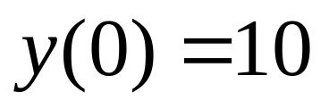
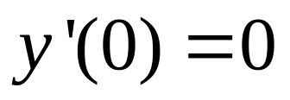
Example 11-3. Solve DE below with MATLAB.
>> y = dsolve('D2y + 3*Dy + 2*y = 24', 'y(0)=10', 'Dy(0)=0')
y =
12+2*exp(-2*t)-4*exp(-t)
>> ezplot(y, [0 6])

Slide 9
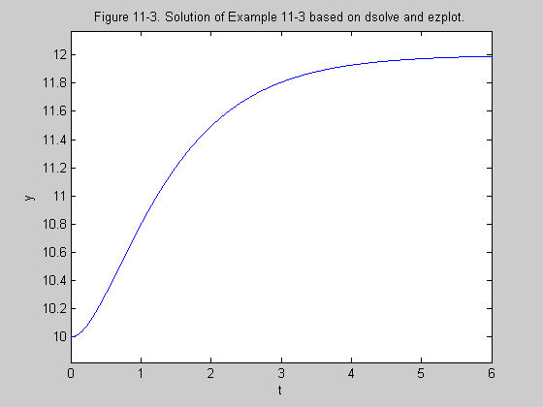

Slide 10
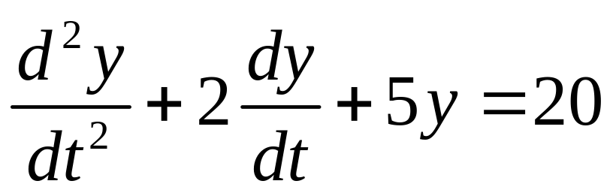
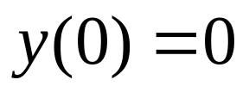
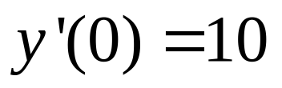
Example 11-4. Solve DE below with MATLAB.
>> y = dsolve('D2y + 2*Dy + 5*y = 20',
'y(0) = 0', 'Dy(0) = 10')
y =
4+3*exp(-t)*sin(2*t)-4*exp(-t)*cos(2*t)
>>ezplot(y, [0 5]}

Slide 11
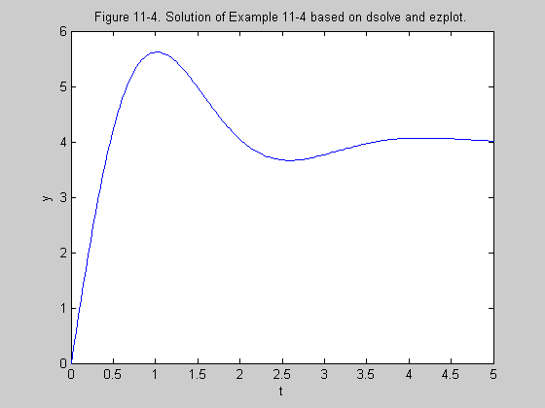

Slide 12
Symbolic Laplace Transform
Establish t and s as symbolic variables.
>> syms t s
The time function f is then formed and the Laplace transform command is
>> F = laplace(f)
Some useful simplifications are
>> pretty(F)
>> simplify(F)

Slide 13
Symbolic Inverse Laplace Transform
Establish t and s as symbolic variables.
>> syms t s
The Laplace function F is then formed and the inverse Laplace transform command is
>> f = ilaplace(F)
The simplification operations may also be useful for inverse transforms.

Slide 14
Example 11-5. Determine the Laplace transform of f(t)=5t with MATLAB.
>>syms t s
>> f = 5*t
f =
5*t
>> F = laplace(f)
F =
5/s^2

Slide 15
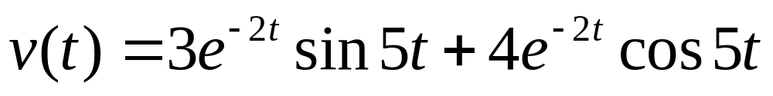
Example 11-6. Determine the Laplace transform of the function below using MATLAB.
>> syms t s
>> v = 3*exp(-2*t)*sin(5*t)
+ 4*exp(-2*t)*cos(5*t)
v =
3*exp(-2*t)*sin(5*t)+4*exp(-2*t)*cos(5*t)

Slide 16
Example 11-6. Continuation.
>> V = laplace(v)
V =
15/((s+2)^2+25)+4*(s+2)/((s+2)^2+25)
>> V=simplify(V)
V =
(23+4*s)/(s^2+4*s+29)

Slide 17
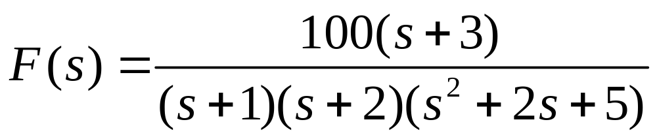
Example 11-7. Determine the inverse transform of the function below using MATLAB.
>> syms t s
>> F=100*(s+3)/((s+1)*(s+2)*(s^2+2*s+5))
F =
(100*s+300)/(s+1)/(s+2)/(s^2+2*s+5)

Slide 18
Example 11-7. Continuation.
>> f = ilaplace(F)
f =
50*exp(-t)-20*exp(-2*t)-30*exp(-t)*cos(2*t)-10*exp(-t)*sin(2*t)
>> pretty(f)
50 exp(-t) - 20 exp(-2 t) - 30 exp(-t) cos(2 t) - 10 exp(-t) sin(2 t)

Slide 19
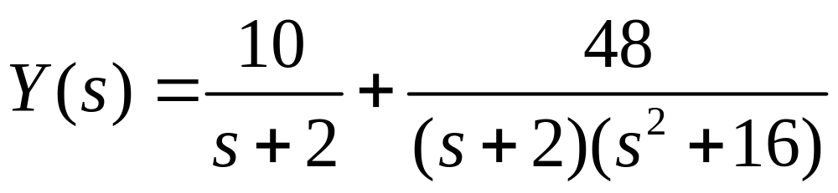
Example 11-8. Determine the inverse transform of the function below using MATLAB.
>> syms t s
>> Y = 10/(s+2) + 48/((s+2)*(s^2+16))
Y =
10/(s+2)+48/(s+2)/(s^2+16)

Slide 20
Example 11-8. Continuation.
>> y = ilaplace(Y)
y =
62/5*exp(-2*t)-12/5*cos(16^(1/2)*t)+3/10*16^(1/2)*sin(16^(1/2)*t)
>> y=simplify(y)
y =
62/5*exp(-2*t)-12/5*cos(4*t)+6/5*sin(4*t)

